Slide 1
Roll No : 08
Class : M.Sc. (Computer Science) - I
Name : Chavan Amar Rajendra
Subject : Database Technology
Seminar topic : JAVA RMI

Slide 2
INTRODUCTION -
RMI (Remote Method Invocation) :-
The RMI (Remote Method Invocation) is an API that provides a mechanism to create distributed application in java. The RMI allows an object to invoke methods on an object running in another JVM.
The RMI provides remote communication between the applications using two objects stub and skeleton.

Slide 3
Stub :-
The stub is an object, acts as a gateway for the client side. All the outgoing requests are routed through it. It resides at the client side and represents the remote object. When the caller invokes method on the stub object, it does the following tasks
It initiates a connection with remote Virtual Machine (JVM),
It writes and transmits (marshals) the parameters to the remote Virtual Machine (JVM),
It waits for the result
It reads (unmarshals) the return value or exception, and
It finally, returns the value to the caller.

Slide 4
Skeleton :-
The skeleton is an object, acts as a gateway for the server side object. All the incoming requests are routed through it. When the skeleton receives the incoming request, it does the following task :
It reads the parameter for the remote method
It invokes the method on the actual remote object, and
It writes and transmits (marshals) the result to the caller.

Slide 5
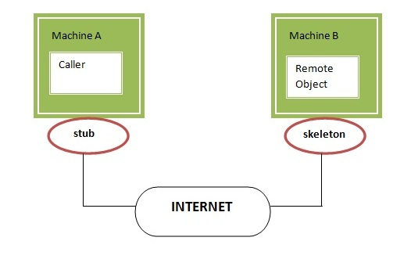

Slide 6
THANK YOU….

